Slide 1
Fe Deficiency Detection & SHAP →→ Index Purpose - Remove noisy beginning and ending spectra - Results of All combinations

Slide 2
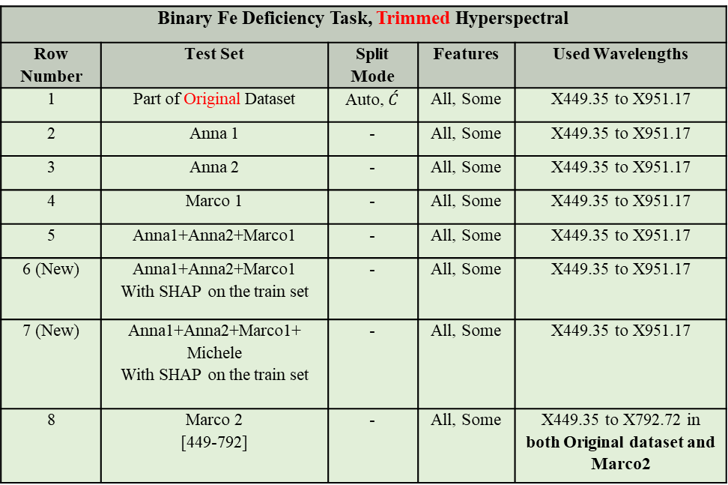
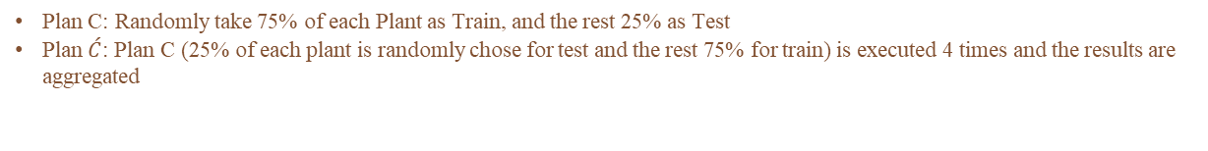
Tested States = 18
Binary Fe Deficiency Task, Trimmed Hyperspectral
Row Number | Test Set | Split Mode | Features | Used Wavelengths
1 | Part of Original Dataset | Auto, $\acute{C}$ | All, Some | X449.35 to X951.17
2 | Anna 1 | - | All, Some | X449.35 to X951.17
3 | Anna 2 | - | All, Some | X449.35 to X951.17
4 | Marco 1 | - | All, Some | X449.35 to X951.17
5 | Anna1+Anna2+Marco1 | - | All, Some | X449.35 to X951.17
6 (New) | Anna1+Anna2+Marco1 With SHAP on the train set | - | All, Some | X449.35 to X951.17
7 (New) | Anna1+Anna2+Marco1+ Michele With SHAP on the train set | - | All, Some | X449.35 to X951.17
8 | Marco 2 [449-792] | - | All, Some | X449.35 to X792.72 in both Original dataset and Marco2
Plan C: Randomly take 75% of each Plant as Train, and the rest 25% as Test
Plan $\acute{C}$: Plan C (25% of each plant is randomly chose for test and the rest 75% for train) is executed 4 times and the results are aggregated

Slide 3
Names used in the experiments
The name “Original Dataset” refers to “Dati_HIS_Serra_Cs_Hv_Sl_Zm_no_Fe.txt”
The name “Anna1” refers to “Exp_I_Anna_Fe_Tomato.txt.txt”
The name “Anna2” refers to “Exp_II_Anna_Fe_Tomato.txt”
The name “Marco1” refers to “Exp_Marco_tesista_Fe_Lupino.txt”
The name “Marco2” refers to “Marco_lupin_Polypen_last_day_24_0_2025.txt”

Slide 4


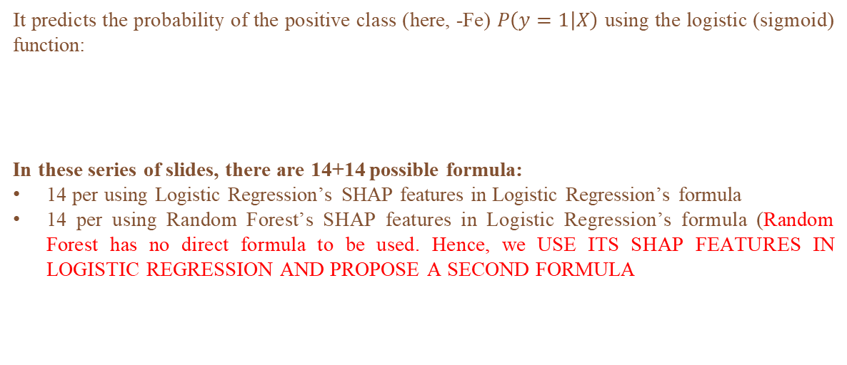
Logistic Regression Formula
It predicts the probability of the positive class (here, -Fe) $P\left(y=1 | X\right)$ using the logistic (sigmoid) function:
In these series of slides, there are 14+14 possible formula:
14 per using Logistic Regression’s SHAP features in Logistic Regression’s formula
14 per using Random Forest’s SHAP features in Logistic Regression’s formula (Random Forest has no direct formula to be used. Hence, we USE ITS SHAP FEATURES IN LOGISTIC REGRESSION AND PROPOSE A SECOND FORMULA
$$P\left(y=1 | X\right)=\frac{1}{1+e^{−(Intercept+\sum{Coefficients.Feature})}}$$
2 Formula will be chosen, both when “Anna1+Anna2+Marco1” is used as the test set and “all features”, unless you prefer one “Some features” over “all features”

Slide 5
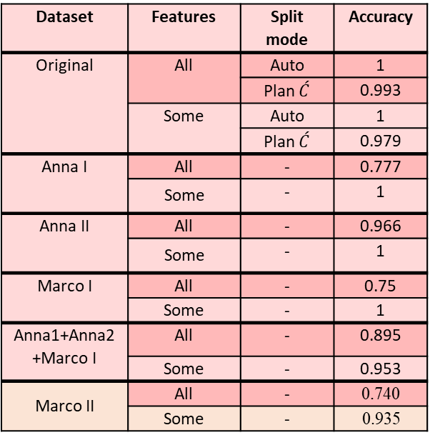
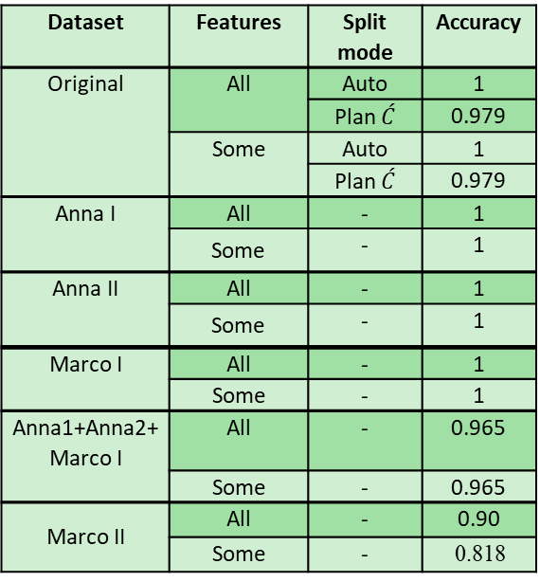
Tested States and Results for Logistic Regression and Random Forest
Dataset | Features | Split mode | Accuracy
Original | All | Auto | 1
 |  | Plan $\acute{C}$ | 0.993
 | Some | Auto | 1
 |  | Plan $\acute{C}$ | 0.979
Anna I | All | - | 0.777
 | Some | - | 1
Anna II | All | - | 0.966
 | Some | - | 1
Marco I | All | - | 0.75
 | Some | - | 1
Anna1+Anna2+Marco I | All | - | 0.895
 | Some | - | 0.953
Marco II | All | - | 0.740
 | Some | - | 0.935
Dataset | Features | Split mode | Accuracy
Original | All | Auto | 1
 |  | Plan $\acute{C}$ | 0.979
 | Some | Auto | 1
 |  | Plan $\acute{C}$ | 0.979
Anna I | All | - | 1
 | Some | - | 1
Anna II | All | - | 1
 | Some | - | 1
Marco I | All | - | 1
 | Some | - | 1
Anna1+Anna2+Marco I | All | - | 0.965
 | Some | - | 0.965
Marco II | All | - | 0.90
 | Some | - | 0.818
Logistic Regression
Random Forest

Slide 6
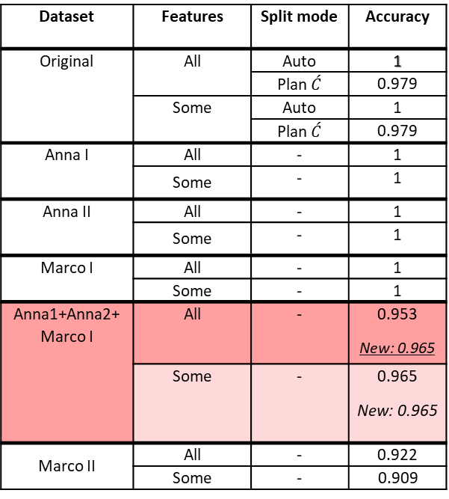
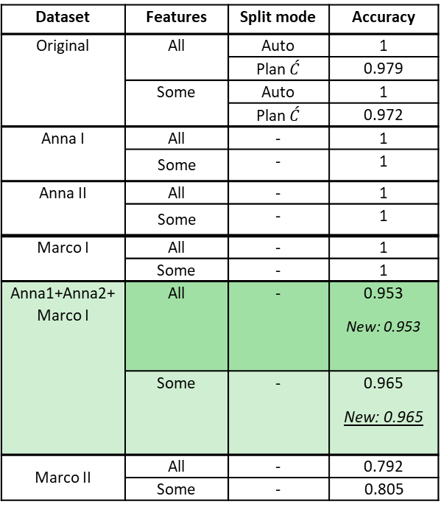
Tested States and Results for Logistic Regression and Random Forest
Using SHAP Features in “Trimmed Wavelengths” state
Dataset | Features | Split mode | Accuracy
Original | All | Auto | 1
 |  | Plan $\acute{C}$ | 0.979
 | Some | Auto | 1
 |  | Plan $\acute{C}$ | 0.979
Anna I | All | - | 1
 | Some | - | 1
Anna II | All | - | 1
 | Some | - | 1
Marco I | All | - | 1
 | Some | - | 1
Anna1+Anna2+Marco I | All | - | 0.953 New: 0.965
 | Some | - | 0.965 New: 0.965
Marco II | All | - | 0.922
 | Some | - | 0.909
Dataset | Features | Split mode | Accuracy
Original | All | Auto | 1
 |  | Plan $\acute{C}$ | 0.979
 | Some | Auto | 1
 |  | Plan $\acute{C}$ | 0.972
Anna I | All | - | 1
 | Some | - | 1
Anna II | All | - | 1
 | Some | - | 1
Marco I | All | - | 1
 | Some | - | 1
Anna1+Anna2+Marco I | All | - | 0.953 New: 0.953
 | Some | - | 0.965 New: 0.965
Marco II | All | - | 0.792
 | Some | - | 0.805
Used For Index/Formula
LR’s SHAP Features in LR
RF’s SHAP Features in RF

Slide 7
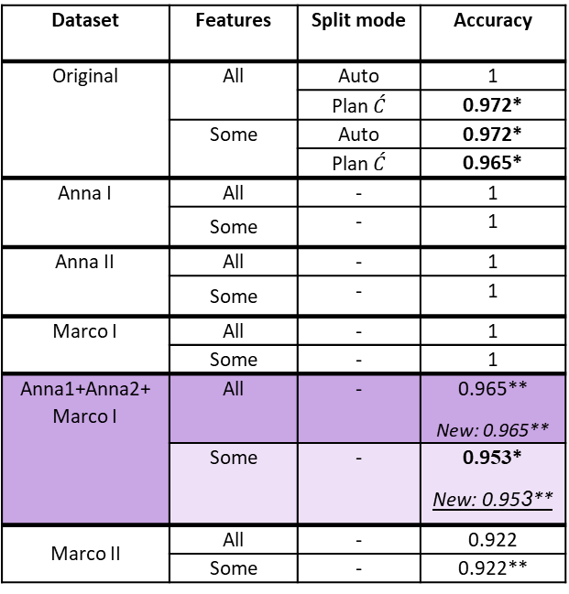
Tested States and Results for Logistic Regression Putting Random Forest’s
Using SHAP Features in “Trimmed Wavelengths” state
Dataset | Features | Split mode | Accuracy
Original | All | Auto | 1
 |  | Plan $\acute{C}$ | 0.972*
 | Some | Auto | 0.972*
 |  | Plan $\acute{C}$ | 0.965*
Anna I | All | - | 1
 | Some | - | 1
Anna II | All | - | 1
 | Some | - | 1
Marco I | All | - | 1
 | Some | - | 1
Anna1+Anna2+Marco I | All | - | 0.965** New: 0.965**
 | Some | - | 0.953* New: 0.953**
Marco II | All | - | 0.922
 | Some | - | 0.922**
In comparison with the Logistic Regression’s table on slide 6:
* denotes that cell’s value has decreased
** denotes that cell’s value has increased
Other cells’ values have not changed
Used For Index/Formula
RF’s SHAP Features in LR

Slide 8
Tested States and Results for Logistic Regression and Random Forest
All Trimmed Wavelengths Considered
Dataset | Features | Split mode | Accuracy
Anna1+Anna2+Marco I | All | - | 0.895
 | Some | - | 0.953
Anna1+Anna2+Marco I+ Michele | All | - | 0.572
 | Some | - | 0.707
Dataset | Features | Split mode | Accuracy
Anna1+Anna2+Marco I | All | - | 0.965
 | Some | - | 0.965
Anna1+Anna2+Marco I+ Michele | All | - | 0.637
 | Some | - | 0.624
Logistic Regression
Random Forest

Slide 9
Tested States and Results for Logistic Regression and Random Forest
Using SHAP Features in “Trimmed Wavelengths” state
Dataset | Features | Split mode | Accuracy
Anna1+Anna2+Marco I | All | - | 0.965
Anna1+Anna2+Marco I+ Michele | All | - | 0.68
Dataset | Features | Split mode | Accuracy
Anna1+Anna2+Marco I | All | - | 0.953
Anna1+Anna2+Marco I+ Michele | All | - | 0.65
LR’s SHAP Features in LR
RF’s SHAP Features in RF
Dataset | Features | Split mode | Accuracy
Anna1+Anna2+Marco I | All | - | 0.965
Anna1+Anna2+Marco I+ Michele | All | - | 0.66
Random Forest’s SHAP Features in LR

Slide 10
New Proposed Formula/Indexes (Applying SHAP on the Train set, not Test set)
If We use Trimmed Wavelengths (from X449.35 to X951.17)
1) Using Logistic Regression’s SHAP FEATURES (All Wavelengths):
$$(\text{6}\text{.}21+{4.73}_{X714.55}+{3.76}_{X717.54}+{4.19}_{X711.56}+{1.53}_{X720.54}+{3.81}_{X708.57}+{0.19}_{X723.53}−{1.25}_{X726.53}−{1.75}_{X729.53}−{0.98}_{X819.95})$$
2) Using Random Forest’s SHAP FEATURES inside Logistic Regression (All Wavelengths):
$$\text{7}\text{.}\text{19 }+{2.13}_{X702.58}+{2.99}_{X714.55}+{2.73}_{X705.57}+{3.14}_{X708.57}+{3.15}_{X711.56}+{1.83}_{X717.54}+{0.15}_{X563.24}+{0.11}_{X542.68}−{0.31}_{X720.54})$$

Slide 11
Tested States and Results for Logistic Regression and Random Forest
Using a modified Tran set (36 –N+Fe samples added )
Dataset | Features | Split mode | Accuracy
Anna1+Anna2+Marco I+ Michele | All | - | 0.699
Dataset | Features | Split mode | Accuracy
Anna1+Anna2+Marco I+ Michele | All | - | 0.62
Logistic Regression
Random Forest
Use SHAP Features in “Trimmed Wavelengths” state
Dataset | Features | Split mode | Accuracy
Anna1+Anna2+Marco I+ Michele | All | - | 0.96
Dataset | Features | Split mode | Accuracy
Anna1+Anna2+Marco I+ Michele | All | - | 0.70
LR’s SHAP Features in LR
RF’s SHAP Features in RF
Dataset | Features | Split mode | Accuracy
Anna1+Anna2+Marco I+ Michele | All | - | 0.97
Random Forest’s SHAP Features in LR

Slide 12
Updated for New Train Set
New Proposed Formula/Indexes (Applying SHAP on the Train set, not Test set)
If We use Trimmed Wavelengths (from X449.35 to X951.17)
1) Using Logistic Regression’s SHAP FEATURES (All Wavelengths):
$$(\text{−}\text{1}\text{.}\text{5}+{1.59}_{X714.55}+{4.57}_{X717.54}−{2.22}_{X711.56}+{5.83}_{X720.54}−{5.44}_{X708.57}+{5.64}_{X723.53}−{1.51}_{X726.53}−{7.2}_{X729.53}−{1.35}_{X819.95})$$
2) Using Random Forest’s SHAP FEATURES inside Logistic Regression (All Wavelengths):
$$\text{−}\text{0}\text{.}\text{6}−{4.78}_{X702.58}+{5.88}_{X714.55}−{1.63}_{X705.57}+{2.44}_{X708.57}+5_{X711.56}+{2.68}_{X717.54}−{10.35}_{X563.24}+{10.32}_{X542.68}−{8.33}_{X720.54})$$

Slide 13
Tested States and Results for Logistic Regression and Random Forest
Using New SHAP Features in “Trimmed Wavelengths” state
Dataset | Features | Split mode | Accuracy
Anna1+Anna2+Marco I+ Michele | All | - | 0.90
Dataset | Features | Split mode | Accuracy
Anna1+Anna2+Marco I+ Michele | All | - | 0.72
LR’s SHAP Features in LR
RF’s SHAP Features in RF
Dataset | Features | Split mode | Accuracy
Anna1+Anna2+Marco I+ Michele | All | - | 0.88
Random Forest’s
SHAP Features in LR

Slide 14
Updated for New Train Set, New SHAP Features
New Proposed Formula/Indexes (Applying SHAP on the Train set, not Test set)
If We use Trimmed Wavelengths (from X449.35 to X951.17)
1) Using Logistic Regression’s SHAP FEATURES (All Wavelengths):
$$(\text{−}\text{0}\text{.}\text{94}+{8.28}_{X948.10}−{0.06}_{X941.95}+{2.22}_{X945.02}+{6.8}_{X951.17}−{4.63}_{X723.53}−{6.12}_{X938.88}−{12.35}_{X926.61}+{1.45}_{X717.54}−{4.47}_{X726.53})$$
2) Using Random Forest’s SHAP FEATURES inside Logistic Regression (All Wavelengths):
$$\text{−}0.45−{2.28}_{X702.58}+{0.81}_{X705.57}−{1.57}_{X714.55}+{2.98}_{X708.57}+{2.13}_{X711.56}−{0.42}_{X542.68}+{5.66}_{X533.89}−{12.26}_{X563.24}+{6.92}_{X530.96})$$

Slide 15
Basis for “Values” in Tables of the Next Slides
High/Fairly high: high/fairly high values of this feature have a positive impact on the prediction in Summary/BeeSwarm plot.
Low/Fairly low: low/fairly low values of this feature have a positive impact on the prediction in Summary/BeeSwarm plot.
NP: No straightforward pattern was observed in Summary/BeeSwarm plot. I have inserted the plot for your reference.
The numerical values have been extracted from the Bar plots.

Slide 16
Summarized information of SHAP, Original Dataset
Original Dataset, All Features, Auto Split
Linear Logistic Regression Values | Random Forest Values
X717.54, High, 1,59 | X542.68, NP, 0.07
X714.55, High, 1.58 | X708.57, NP, 0.06
X711.56, High, 1.36 | X702.58, NP, 0.05
X720.54, High, 1.23 | X545.62, NP, 0.04
X723.53, High, 1.19 | X569.12, NP, 0.04
X708.57, High, 1.18 | X557.36, NP, 0.04
X726.53, High, 1.16 | X699.60, NP , 0.03
X729.53, High, 1.06 | X711.56, NP, 0.03
X705.57, High, 0.93 | X536.82, NP, 0.03
Coefficients and Intercept Original Dataset, All Features, Auto Split
Linear Logistic Regression Features | Random Forest Values
Intercept: 4.3294 | Intercept: 6.2523
X717.54: 2.4741 | X542.68: 0.0673
X714.55: 2.7901 | X708.57: 4.4048
X711.56: 2.3650 | X702.58: 2.4691
X720.54: 1.3493 | X545.62: 0.1714
X723.53: 0.5854 | X569.12: 0.0139
X708.57: 1.9360 | X557.36: 0.0679
X726.53: -0.5893 | X699.60: 1.2864
X729.53: -1.8170 | X711.56: 4.9857
X705.57: 1.2473 | X536.82: -0.0132
Color & Frequency
Green = 2 repetitions
Conclusion: (708, 711) are important

Slide 17
Summarized information of SHAP, Original Dataset
Original Dataset, Some Features, Auto Split
Linear Logistic Regression Values | Random Forest Values
X714.55, High, 0.76 | X711.56, NP, 0.1
X717.54, High, 0.75 | X708.57, NP, 0.08
X711.56, High, 0.7 | X705.57, NP, 0.07
X708.57, High, 0.65 | X699.60, NP , 0.06
X720.54, High, 0.65 | X717.54, NP, 0.04
X723.53, High, 0.57 | X714.55, NP, 0.03
X705.57, High, 0.56 | X539.75, NP, 0.02
X702.58, High, 0.47 | X702.58, NP, 0.02
X753.55, Low, 0.44 | X554.43, NP, 0.02
Coefficients and Intercept Original Dataset, Some Features, Auto Split
Linear Logistic Regression Features | Random Forest Values
Intercept: 2.3001 | Intercept: 3.0639
X714.55: 1.0693 | X711.56: 1.2115
X717.54: 1.0082 | X708.57: 1.1213
X711.56: 1.0237 | X705.57: 0.9722
X708.57: 0.9641 | X699.60: 0.5882
X720.54: 0.8605 | X717.54: 1.1955
X723.53: 0.7130 | X714.55: 1.2740
X705.57: 0.8591 | X539.75: 0.3851
X702.58: 0.7293 | X702.58: 0.7981
X753.55: -1.1248 | X554.43: 0.4116
Color & Frequency
Green = 2 repetitions
Conclusion: Range [702-717] is important

Slide 18
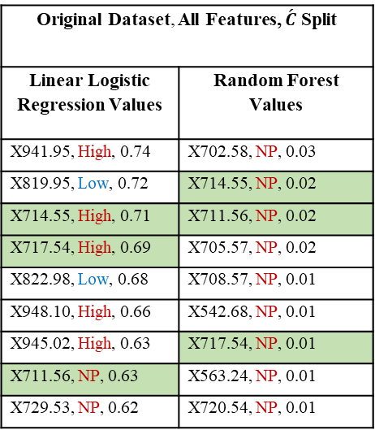
Summarized information of SHAP, Original Dataset
Original Dataset, All Features, $\acute{C}$ Split
Linear Logistic Regression Values | Random Forest Values
X941.95, High, 0.74 | X702.58, NP, 0.03
X819.95, Low, 0.72 | X714.55, NP, 0.02
X714.55, High, 0.71 | X711.56, NP, 0.02
X717.54, High, 0.69 | X705.57, NP, 0.02
X822.98, Low, 0.68 | X708.57, NP, 0.01
X948.10, High, 0.66 | X542.68, NP, 0.01
X945.02, High, 0.63 | X717.54, NP, 0.01
X711.56, NP, 0.63 | X563.24, NP, 0.01
X729.53, NP, 0.62 | X720.54, NP, 0.01
Coefficients and Intercept Original Dataset, All Features, C Prime
Linear Logistic Regression Features | Random Forest Values
Avg Intercept: 4.0532 | Averaged Intercept: 7.9441
X941.95: 1.1208 | X702.58: 2.3470
X819.95: -1.9850 | X714.55: 3.3880
X714.55: 4.1680 | X711.56: 3.5668
X717.54: 3.6809 | X705.57: 3.0598
X822.98: -1.8298 | X708.57: 3.5459
X948.10: 1.1345 | X542.68: 0.0108
X945.02: 0.9918 | X717.54: 2.0401
X711.56: 4.1968 | X563.24: 0.0432
X729.53: -1.1581 | X720.54: -0.4862
Color & Frequency
Green = 2 repetitions
Conclusion: Range [711-717] is important

Slide 19
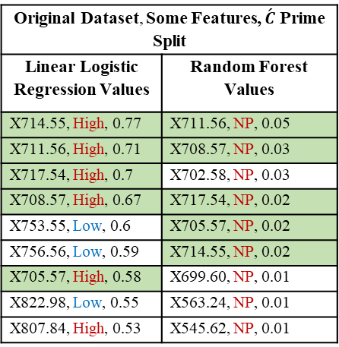
Summarized information of SHAP, Original Dataset
Coefficients and Intercept Original Dataset, Some Features, C Prime
Linear Logistic Regression Features | Random Forest Values
Avg Intercept: 4.0698 | Avg Intercept: 6.7436
X714.55: 2.3270 | X711.56: 2.7625
X711.56: 2.0583 | X708.57: 2.7578
X717.54: 2.3643 | X702.58: 1.7994
X708.57: 1.8129 | X717.54: 1.5362
X753.55: -0.7950 | X705.57: 2.3455
X756.56: -0.8024 | X714.55: 2.6718
X705.57: 1.49224 | X699.60: 1.0591
X822.98: -0.2587 | X563.24: 0.0001
X807.84: 0.6406 | X545.62: 0.0774
Original Dataset, Some Features, $\acute{C}$ Prime Split
Linear Logistic Regression Values | Random Forest Values
X714.55, High, 0.77 | X711.56, NP, 0.05
X711.56, High, 0.71 | X708.57, NP, 0.03
X717.54, High, 0.7 | X702.58, NP, 0.03
X708.57, High, 0.67 | X717.54, NP, 0.02
X753.55, Low, 0.6 | X705.57, NP, 0.02
X756.56, Low, 0.59 | X714.55, NP, 0.02
X705.57, High, 0.58 | X699.60, NP, 0.01
X822.98, Low, 0.55 | X563.24, NP, 0.01
X807.84, High, 0.53 | X545.62, NP, 0.01
Color & Frequency
Green = 2 repetitions
Conclusion: Range [705-717] is important

Slide 20
Summarized information of SHAP, Anna I
Coefficients and Intercept Anna I Dataset, All Features
Linear Logistic Regression Features | Random Forest Values
Intercept: 6.2151 | Intercept: 7.4845
X714.55: 4.7333 | X702.58: 2.2528
X717.54: 3.7601 | X714.55: 2.9067
X711.56: 4.1967 | X705.57: 2.8069
X720.54: 1.5390 | X708.57: 3.1755
X708.57: 3.8109 | X711.56: 3.1158
X723.53: 0.1989 | X717.54: 1.5841
X726.53: -1.2555 | X563.24: 0.3005
X819.95: -0.9823 | X542.68: 0.2638
X729.53: -1.7588 | X557.36: 0.1400
Anna I Dataset, All Features
Linear Logistic Regression Values | Random Forest Values
X714.55, High, 1.67 | X702.58, High, 0.08
X717.54, High, 1.62 | X714.55, High, 0.06
X711.56, High, 1.45 | X705.57, High, 0.04
X720.54, High, 1.3 | X708.57, High, 0.04
X708.57, High, 1.27 | X711.56, High, 0.03
X723.53, High, 1.21 | X717.54, High, 0.03
X726.53, High, 1.13 | X563.24, High, 0.02
X819.95, Low, 1.08 | X542.68, High, 0.02
X729.53, High, 1.07 | X557.36, High, 0.02
Color & Frequency
Green = 2
Conclusion: range 708-717 is important

Slide 21
Summarized information of SHAP, Anna I
Coefficients and Intercept Anna I Dataset, Some Features
Linear Logistic Regression Features | Random Forest Values
Intercept: 2.6467 | Intercept: 6.4210
X714.55: 1.3839 | X711.56: 4.1872
X753.55: -0.6876 | X717.54: 2.2730
X756.56: -0.6587 | X708.57: 4.2665
X717.54: 1.3699 | X539.75: 0.4481
X711.56: 1.2908 | X545.62: 0.5545
X708.57: 1.1899 | X648.95: -1.0915
X705.57: 1.0482 | X702.58: 3.1072
X720.54: 1.2811 | X607.46: 0.1902
X807.84: 0.2705 | X554.43: 0.4051
Anna I Dataset, Some Features
Linear Logistic Regression Values | Random Forest Values
X714.55, High, 2.15 | X711.56, High, 0.14
X753.55, Low, 2.08 | X717.54, High, 0.11
X756.56, Low, 1.97 | X708.57, High, 0.09
X717.54, High, 1.91 | X539.75, High, 0.04
X711.56, High, 1.9 | X545.62, High, 0.03
X708.57, High, 1.69 | X648.95, High, 0.02
X705.57, High, 1.33 | X702.58, High, 0.02
X720.54, High, 1.27 | X607.46, High, 0.01
X807.84, High, 1.18 | X554.43, High, 0.01
Color & Frequency
Green = 2
Conclusion: (708, 711, 717) are important

Slide 22
Summarized information of SHAP, Anna II
Anna II Dataset, All Features
Linear Logistic Regression Values | Random Forest Values
X714.55, High, 1.57 | X702.58, High, 0.08
X717.54, High, 1.52 | X714.55, High, 0.06
X711.56, High, 1.38 | X705.57, High, 0.04
X708.57, High, 1.21 | X708.57, High, 0.04
X720.54, High, 1.21 | X711.56, High, 0.03
X723.53, High, 1.13 | X717.54, High, 0.03
X726.53, High, 1.05 | X563.24, High, 0.02
X729.53, High, 1.03 | X542.68, High, 0.02
X705.57, High, 0.97 | X557.36, High, 0.02
Coefficients and Intercept Anna II Dataset, All Features
Linear Logistic Regression Features | Random Forest Values
Intercept: 4.9573 | Intercept: 7.4845
X714.55: 3.1110 | X702.58: 2.2528
X717.54: 2.7198 | X714.55: 2.9067
X711.56: 2.6322 | X705.57: 2.8069
X708.57: 2.1516 | X708.57: 3.1755
X720.54: 1.4670 | X711.56: 3.1158
X723.53: 0.5946 | X717.54: 1.5841
X726.53: -0.6833 | X563.24: 0.3005
X729.53: -1.7990 | X542.68: 0.2638
X705.57: 1.3812 | X557.36: 0.1400
Color & Frequency
Green = 2
Conclusion: range 705-717 is important

Slide 23
Summarized information of SHAP, Anna II
Anna II Dataset, Some Features
Linear Logistic Regression Values | Random Forest Values
X714.55, High, 2.02 | X711.56, High, 0.14
X753.55, Low, 1.94 | X717.54, High, 0.11
X756.56, Low, 1.83 | X708.57, High, 0.09
X711.56, High, 1.8 | X539.75, High, 0.04
X717.54, High, 1.79 | X545.62, High, 0.03
X708.57, High, 1.61 | X702.58, High, 0.02
X705.57, High, 1.28 | X648.95, High, 0.02
X720.54, High, 1.18 | X607.46, High, 0.01
X807.84, High, 1.06 | X554.43, High, 0.01
Coefficients and Intercept Anna II Dataset, Some Features
Linear Logistic Regression Features | Random Forest Values
Intercept: 2.6467 | Intercept: 6.4210
X714.55: 1.3839 | X711.56: 4.1872
X753.55: -0.6876 | X717.54: 2.2730
X756.56: -0.6587 | X708.57: 4.2665
X711.56: 1.2908 | X539.75: 0.4481
X717.54: 1.3699 | X545.62: 0.5545
X708.57: 1.1899 | X702.58: 3.1072
X705.57: 1.0482 | X648.95: -1.0915
X720.54: 1.2811 | X607.46: 0.1902
X807.84: 0.2705 | X554.43: 0.4051
Color & Frequency
Green = 2
Conclusion: (708, 711, 717) are important

Slide 24
Summarized information of SHAP, Marco I
Marco I Dataset, All Features
Linear Logistic Regression Values | Random Forest Values
X714.55, High, 1.62 | X702.58, High, 0.07
X717.54, High, 1.58 | X714.55, High, 0.06
X711.56, High, 1.4 | X705.57, High, 0.04
X729.53, High, 1.24 | X708.57, High, 0.04
X708.57, High, 1.21 | X711.56, High, 0.03
X819.95, Low, 1.18 | X717.54, High, 0.03
X726.53, High, 1.17 | X542.68, High, 0.02
X720.54, High, 1.16 | X563.24, High, 0.02
X750.54, Low, 1.16 | X720.54, High, 0.02
Coefficients and Intercept Marco I Dataset, All Features
Linear Logistic Regression Features | Random Forest Values
Intercept: 4.6265 | Intercept: 7.1975
X714.55: 2.7322 | X702.58: 2.1373
X717.54: 2.5769 | X714.55: 2.9925
X711.56: 2.4944 | X705.57: 2.7387
X729.53: 0.4406 | X708.57: 3.1443
X708.57: 2.2183 | X711.56: 3.1532
X819.95: 0.2611 | X717.54: 1.8365
X726.53: 1.0816 | X542.68: 0.1164
X720.54: 2.1722 | X563.24: 0.1530
X750.54: -3.4669 | X720.54: -0.3160
Color & Frequency
Green = 2
Conclusion: range 708-720 is important

Slide 25
Summarized information of SHAP, Marco I
Marco I Dataset, Some Features
Linear Logistic Regression Values | Random Forest Values
X753.55, Low, 2.44 | X711.56, High, 0.14
X756.56, Low, 2.28 | X717.54, High, 0.11
X714.55, High, 2.08 | X708.57, High, 0.09
X717.54, High, 1.86 | X539.75, High, 0.03
X711.56, High, 1.82 | X545.62, High, 0.03
X708.57, High, 1.61 | X575.01, Fairly High, 0.02
X807.84, High, 1.34 | X648.95, Fairly High, 0.02
X705.57, High, 1.26 | X702.58, Fairly High, 0.02
X880.74, High, 1.2 | X607.46, High, 0.01
Coefficients and Intercept Marco I Dataset, Some Features
Linear Logistic Regression Features | Random Forest Values
Intercept: 2.7404 | Intercept: 6.3480
X753.55: -0.5477 | X711.56: 4.2216
X756.56: -0.5678 | X717.54: 2.2250
X714.55: 1.6474 | X708.57: 4.3132
X717.54: 1.7005 | X539.75: 0.4206
X711.56: 1.4942 | X545.62: 0.5282
X708.57: 1.3356 | X575.01: 0.4795
X807.84: 0.0483 | X648.95: -1.2223
X705.57: 1.1393 | X702.58: 3.1287
X880.74: 0.1786 | X607.46: 0.1225
Color & Frequency
Green = 2
Conclusion: (708, 711, 717) are important

Slide 26
SHAP on Test
Summarized information of SHAP, Anna I + Anna II + Marco I
Anna I + Anna II + Marco I Datasets, All Features
Linear Logistic Regression Values | Random Forest Values
X714.55, High, 1.61 | X702.58, High, 0.08
X717.54, High, 1,56 | X714.55, High, 0.05
X711.56, High, 1.4 | X705.57, High, 0.04
X720.54, High, 1.23 | X708.57, High, 0.04
X708.57, High, 1.22 | X711.56, High, 0.03
X723.53, High, 1.14 | X717.54, High, 0.03
X726.53, High, 1.08 | X563.24, High, 0.02
X729.53, High, 1.05 | X542.68, High, 0.02
X705.57, High, 0.96 | X720.54, High, 0.02
Coefficients and Intercept Merged Dataset, All Features
Linear Logistic Regression Features | Random Forest Values
Intercept: 4.9573 | Intercept: 7.1975
X714.55: 3.1110 | X702.58: 2.1373
X717.54: 2.7198 | X714.55: 2.9925
X711.56: 2.6322 | X705.57: 2.7387
X720.54: 1.4670 | X708.57: 3.1443
X708.57: 2.1516 | X711.56: 3.1532
X723.53: 0.5946 | X717.54: 1.8365
X726.53: -0.6833 | X563.24: 0.1530
X729.53: -1.7990 | X542.68: 0.1164
X705.57: 1.3812 | X720.54: -0.3160
Color & Frequency
Green = 2
Conclusion: range 705-720 is important

Slide 27
Chosen in Formula, USE SHAP IN TRIAN PHASE
Summarized information of SHAP, Anna I + Anna II + Marco I
Coefficients and Intercept Merged Dataset, All Features
Linear Logistic Regression Features | Random Forest Values
Intercept: 6.21 | Intercept: 7.19
X714.55: 4.73 | X702.58: 2.13
X717.54: 3.76 | X714.55: 2.99
X711.56: 4.19 | X705.57: 2.73
X720.54: 1.53 | X708.57: 3.14
X708.57: 3.81 | X711.56: 3.15
X723.53: 0.19 | X717.54: 1.83
X726.53: -1.25 | X563.24: 0.15
X729.53: -1.75 | X542.68: 0.11
X819.95: -0.98 | X720.54: -0.31
Anna I + Anna II + Marco I Datasets, All Features
Linear Logistic Regression Values | Random Forest Values
X714.55, High, 1.6 | X702.58, NP, 0.08
X717.54, High, 1,55 | X714.55, Fairly high, 0.06
X711.56, High, 1.4 | X705.57, NP, 0.04
X720.54, High, 1.24 | X708.57, NP, 0.04
X708.57, High, 1.24 | X711.56, NP, 0.03
X723.53, High, 1.15 | X717.54, Fairly high, 0.03
X726.53, High, 1.08 | X563.24, Fairly high, 0.02
X729.53, High, 1.04 | X542.68, Fairly high, 0.02
X819.95, Low, 0.99 | X720.54, High, 0.02
Color & Frequency
Green = 2
Conclusion: range 705-720 is important

Slide 28
Index Reduction
Chosen in Formula, USE SHAP IN TRAIN PHASE
Summarized information of SHAP, Anna I + Anna II + Marco I
Anna I + Anna II + Marco I Datasets, All Features
Features | Accuracy
Top 3 LR: X714.55, X717.54, X711.56 (index1) | 0.953
Top 3 LR in RF: X714.55, X717.54, X711.56 (index1) | 0.930
Top 3 RF: X702.58, X714.55, X705.57 (index2) | 0.941
Top 3 RF in LR: X702.58, X714.55, X705.57 (index2) | 0.965
Common 4 in LR: X708.57, X711.56, X714.55, X717.54 (index3) | 0.953
Common 4 in RF: X708.57, X711.56, X714.55, X717.54 (index 3) | 0.953
Feature | Accuracy
X702.58 in LR | 0.965
X702.58 in RF | 0.965
X714.55 in LR | 0.941
X714.55 in RF | 0.93
X705.57 in LR | 0.965
X705.57 in RF | 0.965
Test Index 2’s features individually
Intercept: 6.03
Coefficients:
X702.58: 3.05
X714.55: 6.32
X705.57: 4.17
y = $\text{6}\text{.}\text{03} +{3.05}_{X702.58}+{6.32}_{X714.55}+{4.17}_{X705.57}$

Slide 29
SHAP on Test
Summarized information of SHAP, Anna I + Anna II + Marco I
Anna I + Anna II + Marco I Datasets, Some Features
Linear Logistic Regression Values | Random Forest Values
X714.55, High, 2.07 | X711.56, High, 0.14
X753.55, Low, 1,95 | X717.54, High, 0.11
X717.54, High, 1.83 | X708.57, High, 0.09
X756.56, Low, 1.83 | X539.75, High, 0.04
X711.56, High, 1.83 | X545.62, High, 0.03
X708.57, High, 1.62 | X648.95, High, 0.02
X705.57, High, 1.27 | X702.58, High, 0.02
X720.54, High, 1.2 | X607.46, High, 0.01
X807.84, High, 1.02 | X554.43, High, 0.01
Coefficients and Intercept Merged Dataset, Some Features
Linear Logistic Regression Features | Random Forest Values
Intercept: 2.6467 | Intercept: 6.4210
X714.55: 1.3839 | X711.56: 4.1872
X753.55: -0.6876 | X717.54: 2.2730
X717.54: 1.3699 | X708.57: 4.2665
X756.56: -0.6587 | X539.75: 0.4481
X711.56: 1.2908 | X545.62: 0.5545
X708.57: 1.1899 | X648.95: -1.0915
X705.57: 1.0482 | X702.58: 3.1072
X720.54: 1.2811 | X607.46: 0.1902
X807.84: 0.2705 | X554.43: 0.4051
Color & Frequency
Green = 2
Conclusion: (708, 711, 717) are important

Slide 30
Chosen in Formula, USE SHAP IN TRIAN PHASE
Summarized information of SHAP, Anna I + Anna II + Marco I
Anna I + Anna II + Marco I Datasets, Some Features
Linear Logistic Regression Values | Random Forest Values
X714.55, High, 2.05 | X711.56, NP, 0.15
X753.55, Low, 1,95 | X717.54, F High, 0.12
X717.54, High, 1.83 | X708.57, F High, 0.1
X756.56, Low, 1.83 | X539.75, F High, 0.04
X711.56, High, 1.82 | X545.62, F High, 0.03
X708.57, High, 1.63 | X702.58, Low, 0.02
X705.57, High, 1.28 | X648.95, NP, 0.01
X720.54, High, 1.21 | X554.43, NP, 0.01
X807.84, High, 1.13 | X563.24, NP, 0.01
Coefficients and Intercept Merged Dataset, Some Features
Linear Logistic Regression Features | Random Forest Values
Intercept: 2.6467 | Intercept: 6.55
X714.55: 1.3839 | X711.56: 4.14
X753.55: -0.6876 | X717.54: 2.34
X717.54: 1.3699 | X708.57: 4.19
X756.56: -0.6587 | X539.75: 0.42
X711.56: 1.2908 | X545.62: 0.53
X708.57: 1.1899 | X702.58: 3.03
X705.57: 1.0482 | X648.95: -1.03
X720.54: 1.2811 | X554.43: 0.38
X807.84: 0.2705 | X563.24: 0.5
Color & Frequency
Green = 2
Conclusion: (708, 711, 717) are important

Slide 31
Chosen in Formula, USE SHAP IN TRIAN PHASE
Summarized information of SHAP, Anna I + Anna II + Marco I+ Michele
Coefficients and Intercept Merged Dataset, All Features
Linear Logistic Regression Features | Random Forest Values
Intercept: 6.21 | Intercept: 7.19
X714.55: 4.73 | X702.58: 2.13
X717.54: 3.76 | X714.55: 2.99
X711.56: 4.19 | X705.57: 2.73
X720.54: 1.53 | X708.57: 3.14
X708.57: 3.81 | X711.56: 3.15
X723.53: 0.19 | X717.54: 1.83
X726.53: -1.25 | X563.24: 0.15
X729.53: -1.75 | X542.68: 0.11
X819.95: -0.98 | X720.54: -0.31
Anna I + Anna II + Marco I+ Michele Datasets, All Features
Linear Logistic Regression Values | Random Forest Values
X714.55, High, 1.6 | X702.58, NP, 0.08
X717.54, High, 1,55 | X714.55, Fairly high, 0.06
X711.56, High, 1.4 | X705.57, NP, 0.04
X720.54, High, 1.24 | X708.57, NP, 0.04
X708.57, High, 1.23 | X711.56, NP, 0.03
X723.53, High, 1.15 | X717.54, Fairly high, 0.03
X726.53, High, 1.08 | X563.24, Fairly high, 0.02
X729.53, High, 1.04 | X542.68, Fairly high, 0.02
X819.95, Low, 0.99 | X720.54, High, 0.02
Color & Frequency
Green = 2
Conclusion: range 708-720 is important

Slide 32
New Train Set, USE SHAP IN TRIAN PHASE
Summarized information of SHAP, Anna I + Anna II + Marco I+ Michele
Coefficients and Intercept Merged Dataset, All Features
Linear Logistic Regression Features | Random Forest Values
Intercept: -0.94 | Intercept: -0.45
X948.10: 8.28 | X702.58: -2.28
X941.95: -0.06 | X705.57: 0.81
X945.02: 2.22 | X714.55: -1.57
X951.17: 6.8 | X708.57: 2.98
X723.53: 4.63 | X711.56: 2.13
X938.88: -6.12 | X542.68: -0.42
X926.61: -12.35 | X533.89: 5.66
X717.54: 1.45 | X563.24: -12.26
X726.53: -4.47 | X530.96: 6.92
Anna I + Anna II + Marco I+ Michele Datasets, All Features
Linear Logistic Regression Values | Random Forest Values
X948.10, High, 3.24 | X702.58, NP, 0.05
X941.95, High, 3.18 | X705.57, NP, 0.03
X945.02, High, 2.82 | X714.55, Fairly high, 0.03
X951.17, High, 2.6 | X708.57, NP, 0.02
X723.53, High, 2.23 | X711.56, NP, 0.02
X938.88, High, 2.03 | X542.68, High, 0.02
X926.61, High, 1.94 | X533.89, Fairly high, 0.01
X717.54, High, 1.85 | X563.24, Fairly high, 0.01
X726.53, High, 1.81 | X530.96, High, 0.01
No Frequent pattern

Slide 33
Marco II Dataset:
The “Original” Dataset’s ending part was trimmed such that it ends in 792. I also removed one spectrum from “Marco II” to end in 792 as well.
The “Marco II” Dataset’s Beginning part was trimmed such that it begins with 449.
After these steps 1&2, the original and Marco II are in range 449-792. Yet, “Original” has 117 spectra while “Marco II” has 344. To address this, a matching was done to make sure “Marco II” has the exact 117 spectra as “Original” dataset. This matching was as following:
Extract the numeric part of column names that start with X in “Original” dataset. Use the existing column names from the “Marco II” dataset directly. Compare them and extract the ones that are similar.

Slide 34
Summarized information of SHAP, Marco II
Marco II Dataset, All Features
Linear Logistic Regression Values | Random Forest Values
X714.55, High, 1.85 | X708.57, NP, 0.05
X717.54, High, 1.84 | X705.57, NP, 0.04
X720.54, High, 1.66 | X714.55, NP, 0.03
X711.56, High, 1.65 | X717.54, NP, 0.03
X723.53, High, 1.53 | X548.55, NP, 0.03
X708.57, High, 1.44 | X702.58, NP, 0.02
X726.53, High, 1.25 | X699.60, NP, 0.02
X705.57, High, 1.18 | X711.56, NP, 0.02
X729.53, High, 1.04 | X533.89, NP, 0.01
Coefficients and Intercept Marco II Dataset, All Features
Linear Logistic Regression Features | Random Forest Values
Intercept: 4.9573 | Intercept: 7.8021
X714.55: 3.1110 | X708.57: 3.0763
X717.54: 2.7198 | X705.57: 2.6667
X720.54: 1.4670 | X714.55: 2.9084
X711.56: 2.6322 | X717.54: 1.6487
X723.53: 0.5946 | X548.55: 0.1718
X708.57: 2.1516 | X702.58: 2.0821
X726.53: -0.6833 | X699.60: 1.2903
X705.57: 1.3812 | X711.56: 3.0634
X729.53: -1.7990 | X533.89: 0.1354
Color & Frequency
Green = 2
Conclusion: range 705-717 is important

Slide 35
Summarized information of SHAP, Marco II
Coefficients and Intercept Marco II Dataset, Some Features
Linear Logistic Regression Features | Random Forest Values
Intercept: 2.8670 | Intercept: 6.6258
X717.54: 1.2041 | X705.57: 3.9161
X714.55: 1.2667 | X711.56: 4.4758
X723.53: 0.8853 | X560.30: 0.2943
X711.56: 1.2063 | X536.82: 0.4045
X708.57: 1.1338 | X717.54: 2.6737
X726.53: 0.6495 | X702.58: 3.0874
X705.57: 1.0130 | X554.43: 0.2892
X702.58: 0.8697 | X533.89: 0.4506
X747.54: -1.2388 | X513.40: -0.9377
Marco II Dataset, Some Features
Linear Logistic Regression Values | Random Forest Values
X717.54, High, 0.92 | X705.57, NP, 0.12
X714.55, High, 0.91 | X711.56, NP, 0.1
X723.53, High, 0.84 | X560.30, NP, 0.07
X711.56, High, 0.82 | X536.82, NP, 0.04
X708.57, High, 0.72 | X717.54, NP, 0.04
X726.53, High, 0.71 | X702.58, NP, 0.04
X705.57, High, 0.59 | X554.43, NP, 0.03
X702.58, High, 0.45 | X533.89, NP, 0.02
X747.54, High, 0.32 | X513.40, NP, 0.02
Color & Frequency
Green = 2
Conclusion: (702, 705, 711, 717) are important

Slide 36
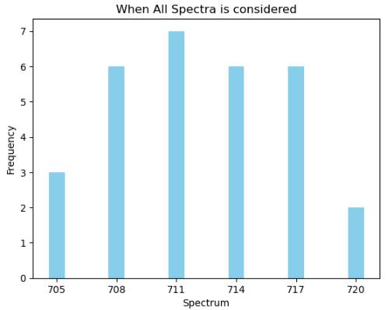
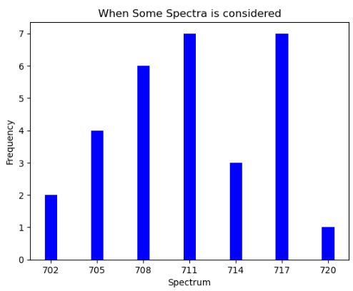
How often do green-highlighted features appear in 'All' versus 'Some' states across all Tables?

Slide 37
The End

